Slide 1
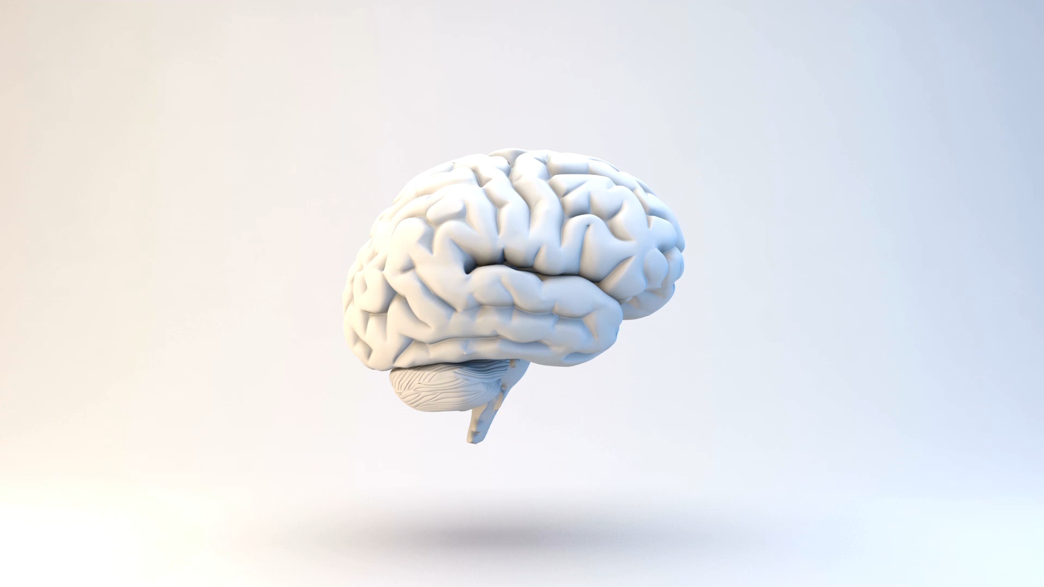
Deep Learning for Vessel Segmentation in Cerebral CTA
A Controlled Ablation of Topology-Aware Loss Functions
Samih Tharwat Amer | Whiting School of Engineering – Johns Hopkins University | EN.525.733 Dr. Nasrabadi

Slide 2
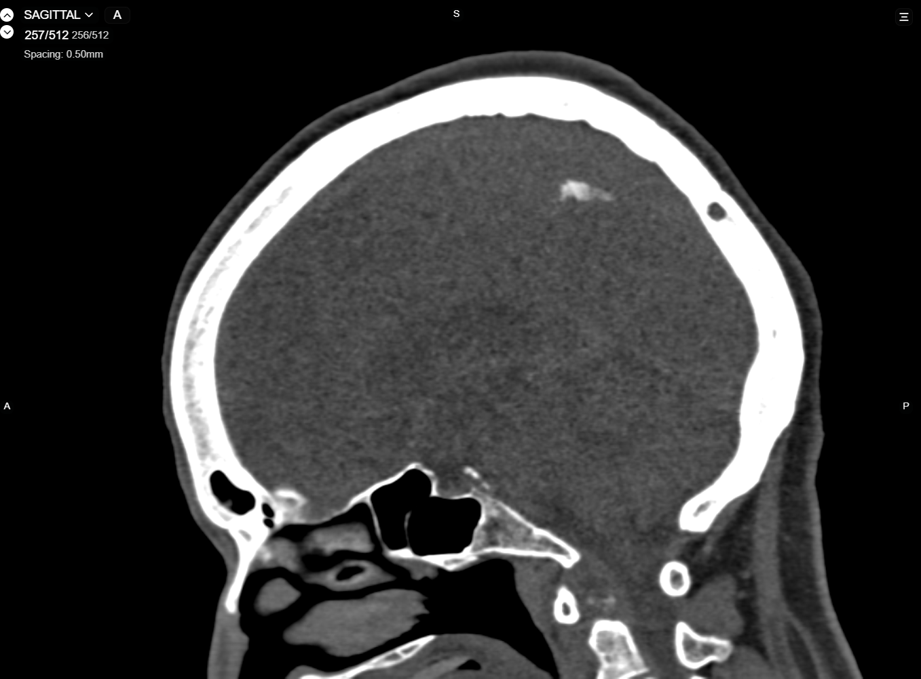
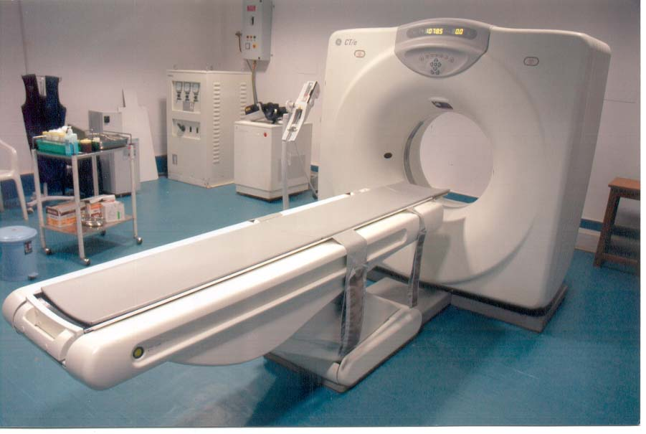
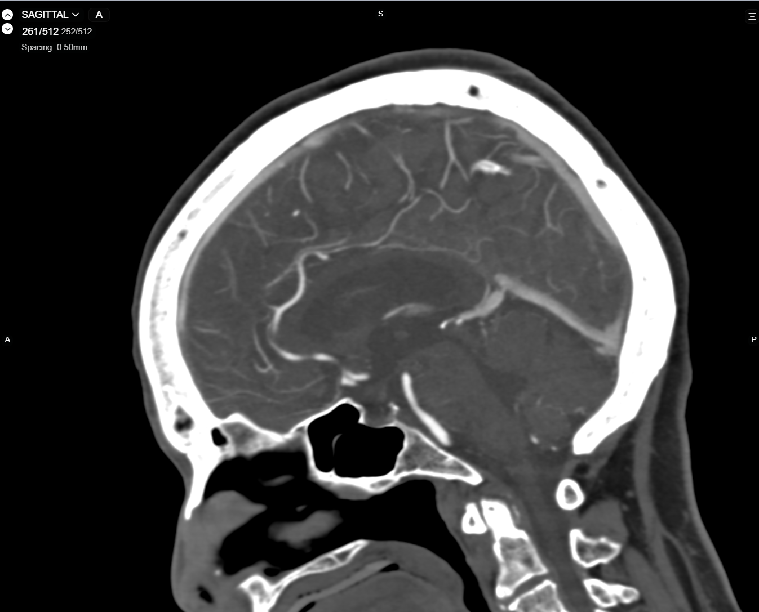
Regular CT
What is a CTA?
Computed Tomography (CT): X-ray based imaging that produces cross-sectional 3D volumes of the body
CT Angiography (CTA): A CT Scan where a patient is injected with a contrast dye that highlights blood vessels
Regular CT: Shows bone and soft tissue – vessels are nearly invisible
CTA: Contrast fills the vasculature, making arteries brighter
This is the imaging modality of choice for stroke triage and aneurysm detection
CTA

Slide 3
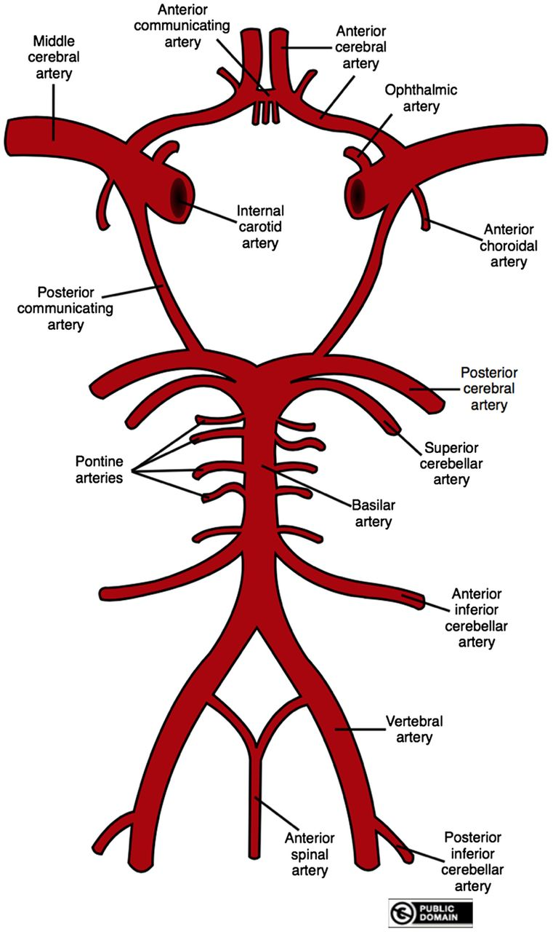
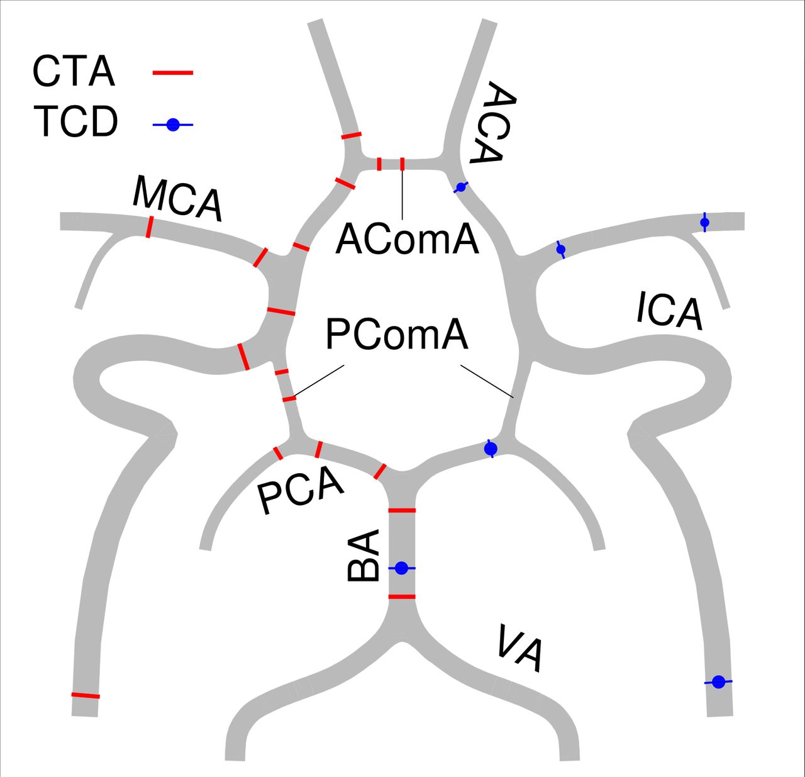
Clinical Motivation
Cerebrovascular Diseases
Leading cause of death and disability worldwide. Accurate vessel segmentation from CTA is essential for diagnosis and surgical planning
Circle of Willis (CoW)
The arterial anastomotic ring at the brain’s base. Provides collateral blood flow pathways critical during vascular occlusion.
Communicating Arteries (Acom, Pcom)
Thin (<1mm diameter) but clinically critical for aneurysm assessment and collateral flow. Most prone to segmentation failure.
Notes:
"Cerebrovascular diseases — stroke, aneurysms, arteriovenous malformations — are a leading cause of death and disability worldwide. Accurate segmentation of cerebral vasculature from CT angiography is essential for diagnosis and surgical planning."
So why do we need automated vessel segmentation? Today, if a neurosurgeon wants a 3D map of a patient's cerebral vasculature — for surgical planning, aneurysm assessment, or stroke triage — a radiologist has to manually trace the vessels slice by slice. That takes hours per scan. It's simply not feasible in an emergency setting where treatment decisions need to happen in minutes.
"Automated segmentation changes that. It can turn a raw CTA scan into a 3D vascular model in seconds, enabling real-time surgical navigation, 3D aneurysm visualization, and rapid collateral flow assessment during
stroke triage.“ "The primary region of interest is the Circle of Willis — the arterial ring at the base of the brain. It has large named arteries — ICA, MCA, basilar — but the thin communicating arteries, the Acom and Pcom, are what matter most. These are the collateral pathways. When a major vessel is blocked during a stroke, whether the patient has intact communicating arteries determines whether blood can reroute. If your segmentation misses or disconnects these, the clinical utility is lost."

Slide 4
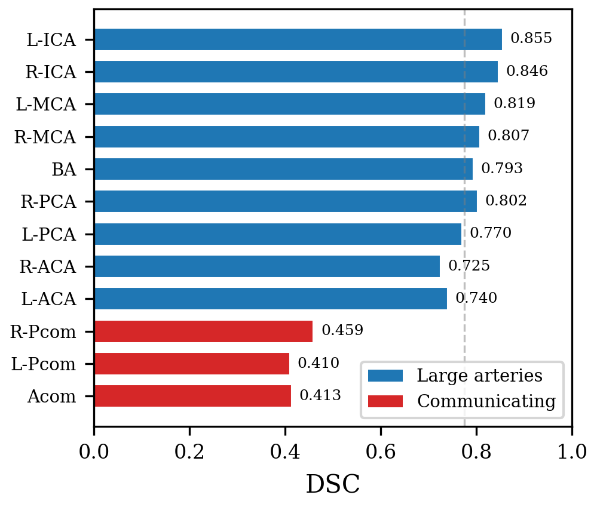
The Problem – Topological Failures
Deep learning segmentation models optimize for voxel overlap – no concept of vessel connectivity
A segmentation can score DSC 0.87 while containing severed vessels and disconnected fragments
Aggregate metrics are misleading – dominated by large, easy arteries; hide failures on thin structures
Clinically useless segmentations can look numerically acceptable
Global DSC: 0.87 R-Pcom DSC: 0.42 L-ACA DSC: 0.46
Notes:
"Here's the core problem. Current deep learning segmentation models are optimized to maximize voxel-level overlap with the ground truth. They have no concept of whether a vessel is connected end-to-end or whether
▎ it's been severed into fragments. A segmentation can score a Dice coefficient of 0.87 (that's the standard overlap metric, essentially measuring what percentage of predicted vessel voxels match the ground truth) — which sounds excellent — while containing completely broken vessels."
▎
▎ "When we actually tested our first model in a clinical 3D viewer, this is exactly what we found. The global metrics looked reasonable, but when we broke it down by individual vessel class, the posterior communicating
▎ artery scored 0.42, and other communicating arteries were similarly poor. The aggregate score was dominated by the large arteries — the ICA, MCA, basilar — which are easy to segment. The thin structures that matter
▎ most for clinical decisions were failing silently."
▎
▎ "So the question becomes: can we train these models to care about connectivity? That's where topology-aware loss functions come in, which we'll get to shortly."

Slide 5
The TopCoW Challenge
Challenge Overview
Evaluation Protocol
MICCAI 2024 Challenge
Topology-aware anatomical segmentation of the Circle of Willis for CTA and MRA
125 CTA + 125 MRA volumes
Expert voxel-level annotations for 13 vessel classes
Key finding from challenge:
Even top teams achieve good aggregate Dice while producing topologically incorrect segmentations
Dice Score (DSC)
Voxel overlap between prediction and ground truth
Centerline Dice (clDice)
Skeleton-level overlap — topology agreement
HD95 (mm)
95th percentile Hausdorff distance — surface accuracy
Betti-0 Error
Connected component mismatch — topological correctness
Notes:
Our work builds on the TopCoW 2024 Challenge — a MICCAI challenge specifically designed to benchmark Circle of Willis segmentation. The challenge provides 125 CTA and 125 MRA volumes with expert voxel-level annotations for 13 vessel classes. What makes TopCoW unique among segmentation challenges is its evaluation protocol: beyond standard Dice and Hausdorff distance, it measures topological correctness using the Betti-0 error — which counts connected component mismatches between prediction and ground truth — and centerline Dice, which evaluates skeleton-level overlap."
>
> "The key finding from the TopCoW challenge is that even top-performing teams achieve good aggregate Dice scores while still producing topologically incorrect segmentations. The communicating arteries, which are the most clinically important structures in the Circle of Willis, remain the weakest point across all submitted methods. This motivated our study: can we specifically improve topology through the loss function alone?"

Slide 6
Related Work & State of the Art
Segmentation Backbone
Topology-Preserving Losses
Other Approaches
nnU-Net
clDice
Persistent Homology
Isensee et al., Nat. Methods 2021
Shit et al., CVPR 2021
Berger, Stucki (MICCAI/ICML)
Self-configuring 3D U-Net. Established Dice+CE as standard. Dominant framework.
Differentiable soft-skeletonization. First topology-preserving loss for tubular structures.
Topological loss via persistence barcodes.
nnU-Net Revisited
Skeleton Recall
NexToU
Isensee et al., MICCAI 2024
Kirchhoff et al., ECCV 2024
Shi et al., 2023
Call for rigorous validation in 3D medical image segmentation.
CPU-precomputed skeletons. Efficient centerline recall.
Topology-aware U-Net architecture.
CBD-Loss
Cascaded U-Net
Shi et al., MICCAI 2024
Rougé et al., PLOS ONE 2024
Joint centerline + boundary optimization.
Topology-aware multi-task approach.
Gap: Existing evaluations confound loss function effects with architectural changes or aggregate-only challenge metrics
Notes:
"The backbone of modern medical image segmentation is nnU-Net by Isensee et al., published in Nature Methods 2021. It established the Dice plus cross-entropy paradigm that nearly all top methods build on. In 2021, Shit et al. at CVPR introduced centerline Dice — clDice — which computes Dice on morphological skeletons using differentiable soft-skeletonization. This was the first loss function to directly penalize topological disconnection in a differentiable way."
>
> "More recently, Kirchhoff et al. at ECCV 2024 proposed Skeleton Recall, which takes a more computationally efficient approach — precomputing binary skeletons on CPU and using them as attention masks. Other related work includes the Centerline Boundary Dice loss from Shi et al. at MICCAI 2024, methods based on persistent homology from Berger and Stucki, and specialized architectures like NexToU."
>
> "The key limitation we identified is that existing evaluations of these topology-aware losses either introduce them alongside architectural changes — making it impossible to attribute improvements to the loss function alone — or they report only aggregate scores on multi-team challenge leaderboards. Our work addresses this gap through a controlled, single-variable ablation."

Slide 7
Hypothesis & Approach
HYPOTHESIS
Topology-aware loss functions will disproportionately improve
segmentation of thin communicating arteries (Acom, Pcom)
Config 1
Config 2
Config 3
Dice + CE
Dice + CE + clDice
Dice + CE + Skeleton Recall
Baseline — overlap only
nnU-Net default
Centerline matching
Shit et al., CVPR 2021
Centerline recall
Kirchhoff et al., ECCV 2024
Controlled ablation: same architecture, same data, same hardware — only the loss function changes
Notes:
"Our hypothesis is that topology-aware loss functions will disproportionately improve segmentation of thin communicating arteries — the Acom and Pcom — which are most prone to topological failure."
>
> "To test this cleanly, we designed a controlled ablation. We hold everything identical — the same 3D U-Net architecture, the same data splits, the same hardware, the same optimizer and hyperparameters — and vary only the loss function. Three configurations: first, Dice plus cross-entropy as the baseline; second, adding soft centerline Dice from Shit et al.; and third, adding Skeleton Recall from Kirchhoff et al. Both topology-aware terms are combined with the base loss at equal weight, alpha equals 0.5."

Slide 8
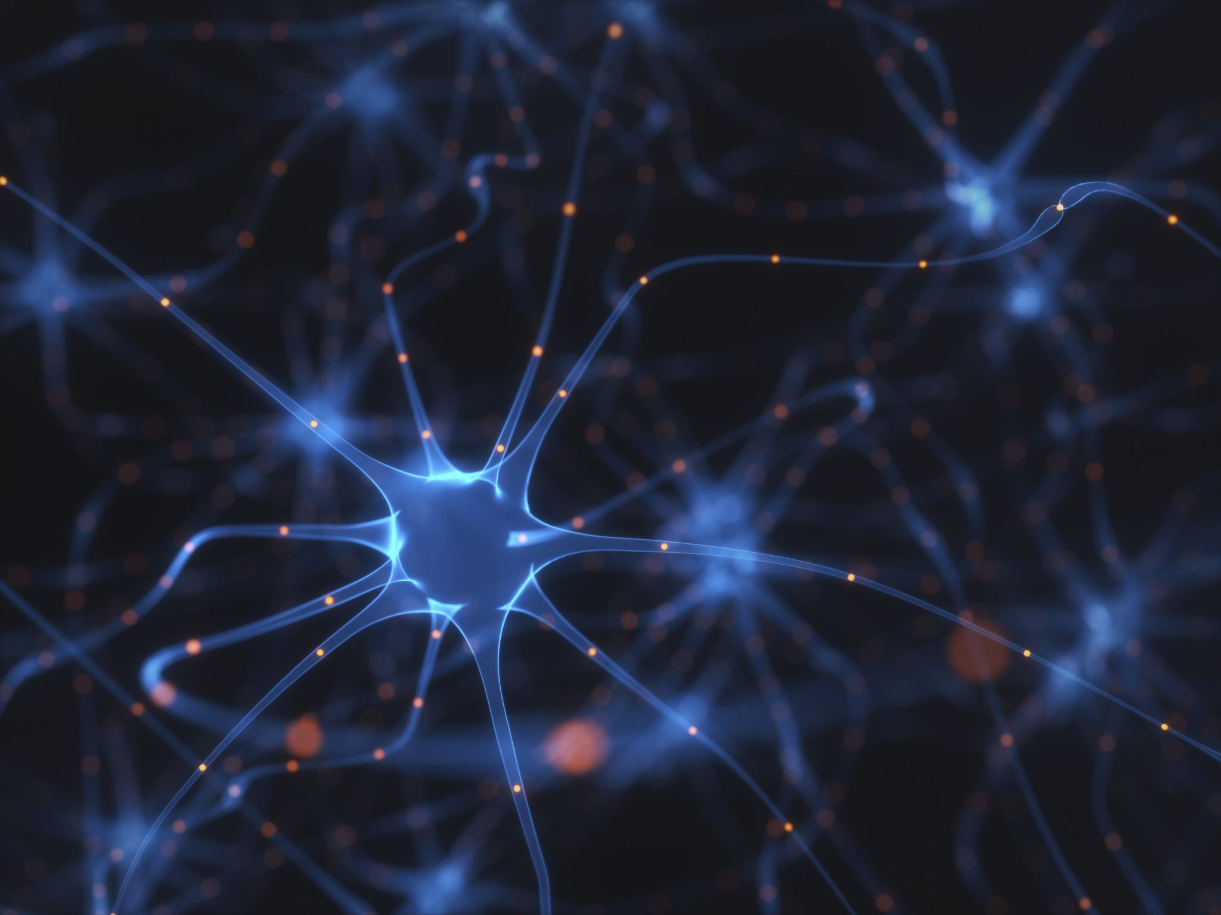







Datasets
TopCow 2024
MICCAI Challenge Dataset
125 CTA volumes with expert annotations
13 Circle of Willis vessel classes
100/25 train/validation split (80/20)
Classes: BA, ICA, MCA, PCA, ACA, Acom, Pcom, 3rd-A2
Used for: From-scratch training
TopBrain 2025
Extended Annotations – Same Scans
25 CTA Volumes (same scans as TopCow subset)
40 vessel classes – 2x more coverage
New: Distal branches, posterior fossa, small arteries, venous sinuses
Binarized: GT covers far more vasculature
Used for: Fine tuning and transfer evaluation

Slide 9
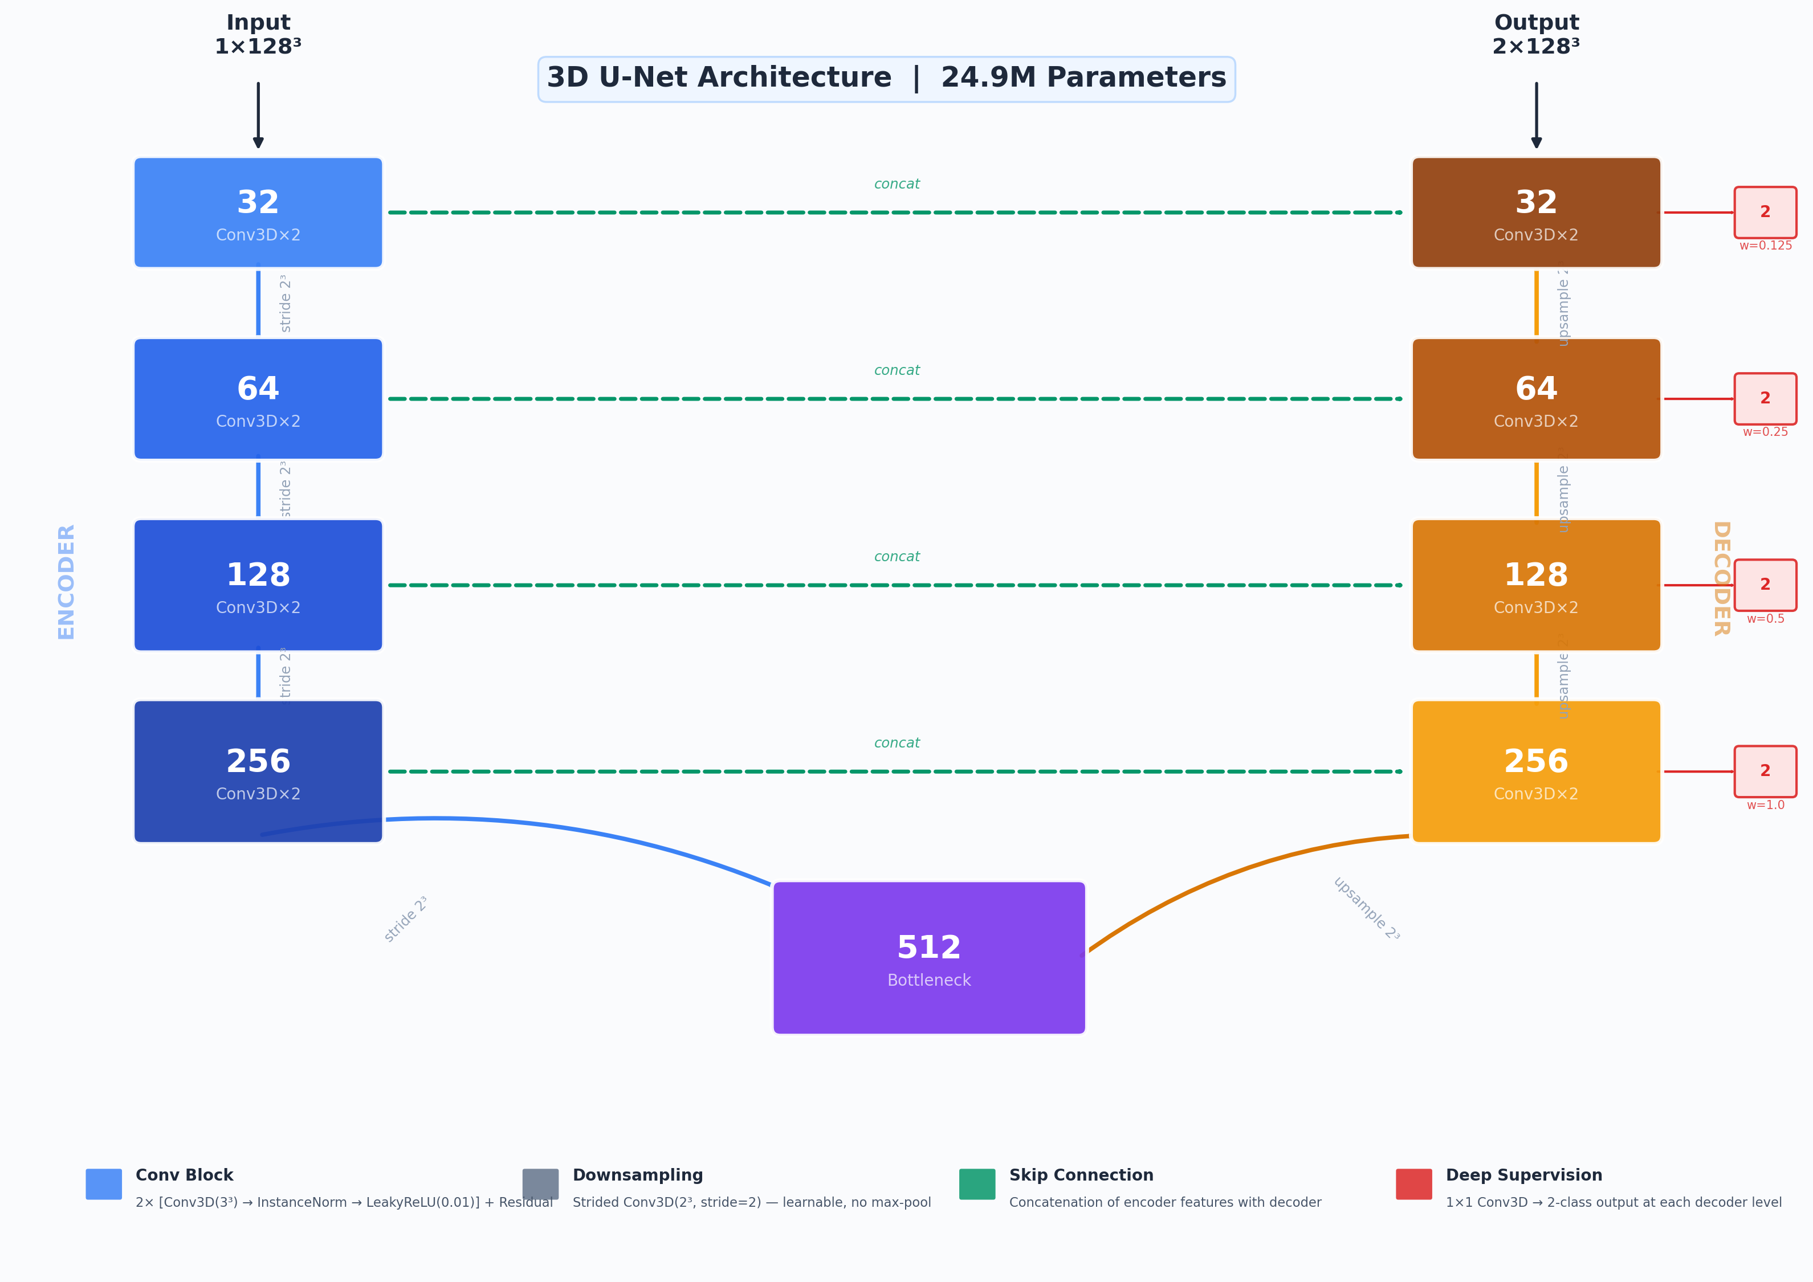
Architecture: 3D U-Net
Encoder 5 stages: 32 → 64 → 128 → 256 → 512 ch
Blocks: 2x Conv3D(3³) + InstanceNorm + LeakyReLU (α=0.01) + residual
DownSampling: Strided 2³ convolutions (learnable, no max-pool)
Upsampling: Transposed convolutions + skip connections (concat)
Deep Supervision: 1x1 heads at each decoder level, weights: 1.0, 0.5, 0.25, 0.125
Parameters: 24.9M (Kaiming normal init)
Design: nnU-Net philosophy (Isensee et al., 2021)
Why 3D U-Net? Strongest controlled baseline — any performance difference attributable to the loss function, not the architecture

Slide 10
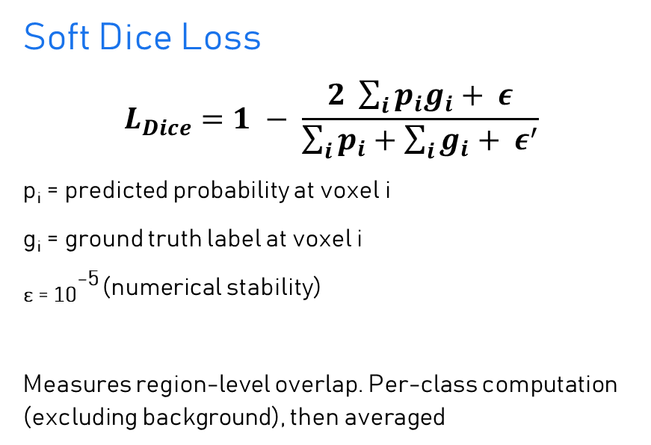
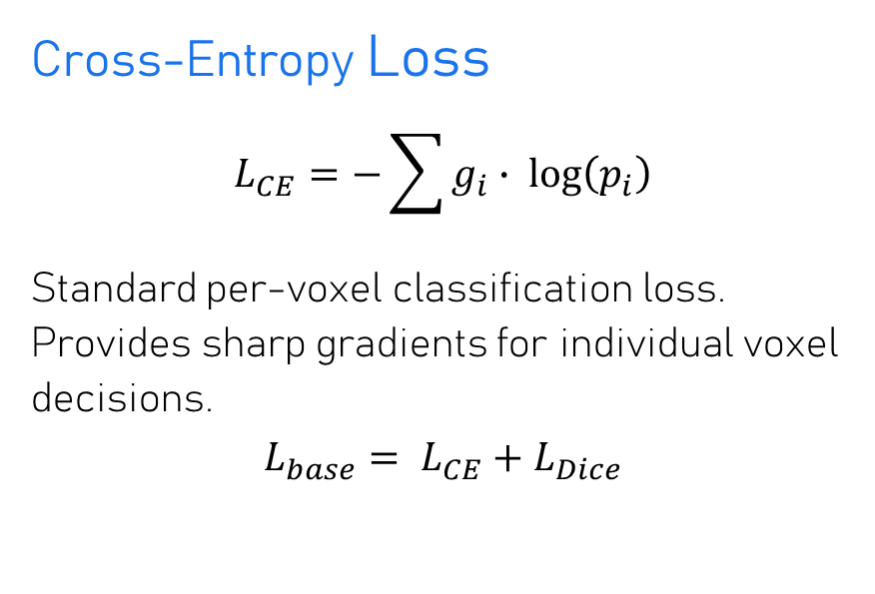
Loss Functions: Dice + Cross-Entropy (Baseline)
Soft Dice Loss
$$L_{Dice}=1 − \frac{2 \sum_{i}{p_{i}g_{i}+ ε}}{\sum_{i}{p_{i}+\sum_{i}{g_{i}+ ε^{′}}}}$$
p_{i} = predicted probability at voxel i
g_{i} = ground truth label at voxel i
_{ɛ = 10}⁻⁵ (numerical stability)
Measures region-level overlap. Per-class computation (excluding background), then averaged
Cross-Entropy Loss
$$L_{CE}=−\sum{g_{i}∙ \log\left(p_{i}\right)}$$
Standard per-voxel classification loss. Provides sharp gradients for individual voxel decisions.
$$L_{base}= L_{CE}+L_{Dice}$$
Limitation: Every voxel receives equal weight. A centerline voxel of a 1mm Pcom gets the same gradient as a surface voxel of the 5mm ICA.

Slide 11
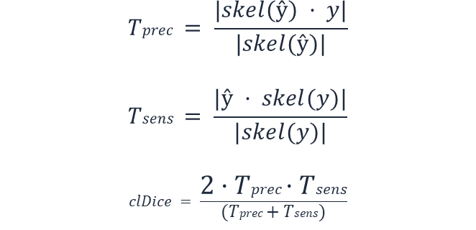
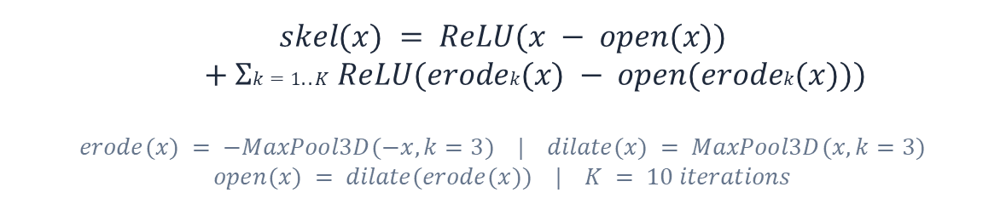
Loss Functions: Soft Centerline Dice (clDice)
Differentiable Soft-Skeletonization
Topology Metrics
$$skel(x) = ReLU(x − open(x))$$
$$+ Σk=1..K ReLU(erodek(x) − open(erodek(x)))$$
$$erode(x) = −MaxPool3D(−x, k=3) | dilate(x) = MaxPool3D(x, k=3)$$
$$open(x) = dilate(erode(x)) | K = 10 iterations$$
$$Tprec = \frac{|skel(ŷ) · y|}{|skel(ŷ)|}$$
$$Tsens = \frac{|ŷ · skel(y)|}{|skel(y)|}$$
$$clDice = \frac{2·Tprec·Tsens}{(Tprec+Tsens)}$$
Combined: $L_{clDice}=\left(1−α\right)∙ L_{base}+ α ∙\left(1−clDice\right) α=0.5$
Intuition: Computes skeletons (centerlines) of both prediction and ground truth, then measures how well they overlap. Directly penalizes topological disconnection — if the prediction's centerline doesn't match the ground truth's centerline, the loss increases. Measures both precision (predicted skeleton inside GT) and sensitivity (GT skeleton covered by prediction).

Slide 12
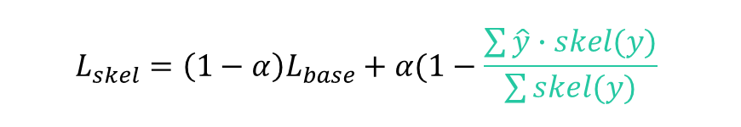
Loss Functions: Skeleton Recall
Skeleton Recall Loss
Key Differences from clDice
$$L_{skel}=\left(1−α\right)L_{base}+α(1−\frac{\sum{\hat{y}∙skel(y)}}{\sum{skel(y)}}$$
CPU precomputation
No GPU-intensive iterative operations
Recall only
Does not measure prediction skeleton precision
Binary skeleton
skel(y) = precomputed binary skeleton (CPU, scikit-image)
ŷ = predicted vessel probability map
α = 0.5
Exact morphological thinning, not soft approximation
Computationally efficient
~13% overhead vs baseline
Intuition: "Did you find the core of every vessel?" Precomputes a 1-voxel-wide centerline of the ground truth, then asks how much of this skeleton the prediction covers. Focuses all gradient signal on centerline voxels — even at the cost of over-segmentation. The base Dice+CE handles false positives; Skeleton Recall ensures the thinnest structures aren't missed.
Summary of Loss Functions
Loss | Topology Signal | Computation | Trade-off
Dice+CE | None | Fastest | No topology awareness
+ clDice | Precision + Recall | GPU-intensive (K=10 iters) | Best aggregate metrics
+ Skeleton Recall | Recall only | CPU precompute (+13%) | Best thin-vessel detection

Slide 13
Training Setup
Hardware
8× NVIDIA A100-SXM4-40GB (AWS p4d.24xlarge)
Training
DDP across all 8 GPUs — identical for all 3 models
Epochs
300 (from-scratch) | 150 (TopBrain fine-tuning)
Optimizer
AdamW (LR = 10⁻³, weight decay = 10⁻⁵)
LR Schedule
Cosine annealing + 10-epoch linear warmup (10⁻⁷ → 10⁻³ → 10⁻⁷)
Patches
128³ voxel crops, 4 per volume, 33% foreground-centered
Batch Size
4 per GPU (32 effective) | Mixed precision (AMP)
Validation
Every 25 epochs | Early stopping patience = 5 cycles
Fine-tuning
Best checkpoint, fresh optimizer, LR = 10⁻⁴, 5-epoch warmup
All training configuration identical across runs — controlled single-variable comparison

Slide 14
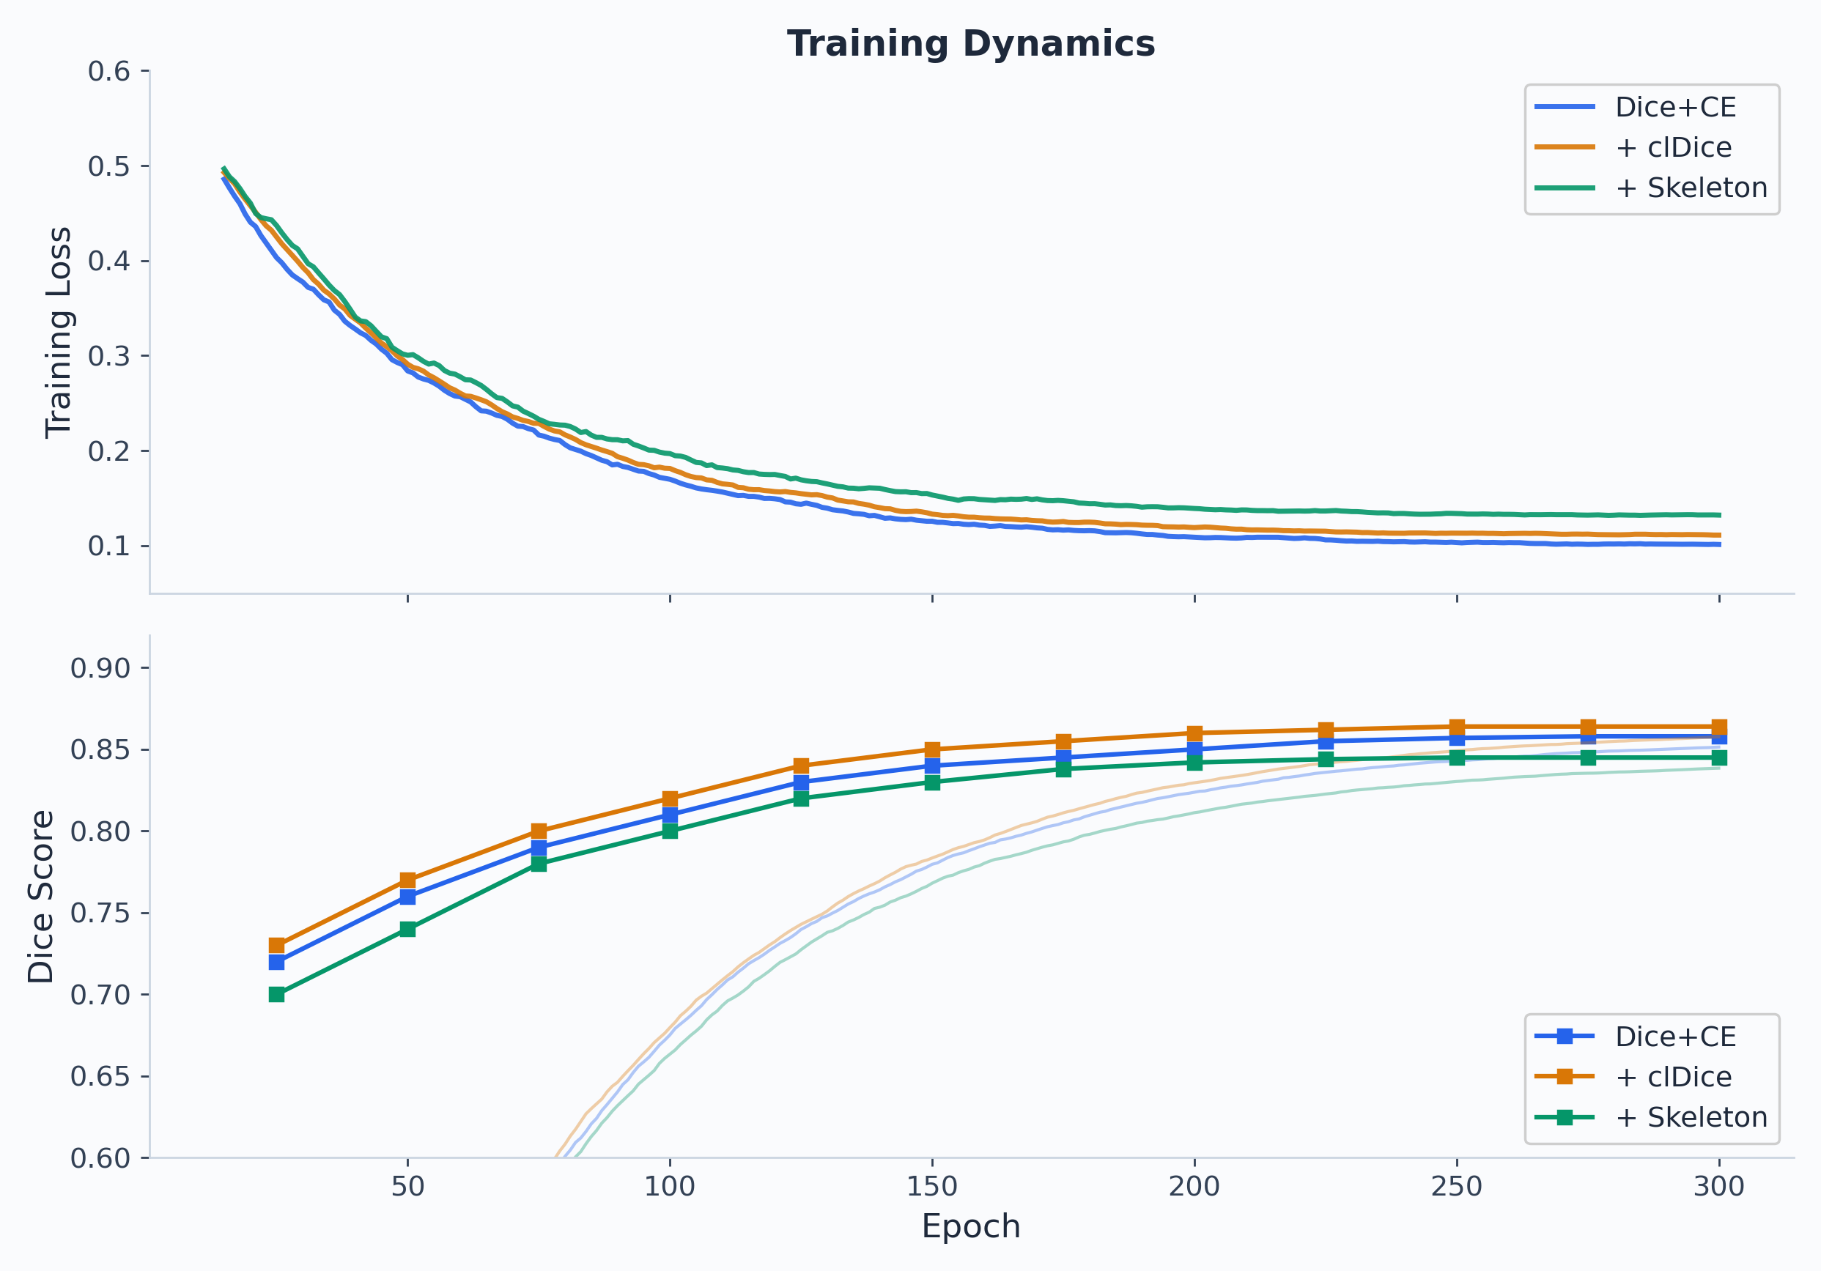
Training Dynamics
All three models converge to similar regions:
Training loss: ~0.10–0.13
Validation Dice: ~0.84–0.86
clDice and Dice+CE are nearly identical
Skeleton Recall runs at slightly higher loss — expected from additional centerline penalty
Stable convergence across all configurations. No NaN batches.

Slide 15
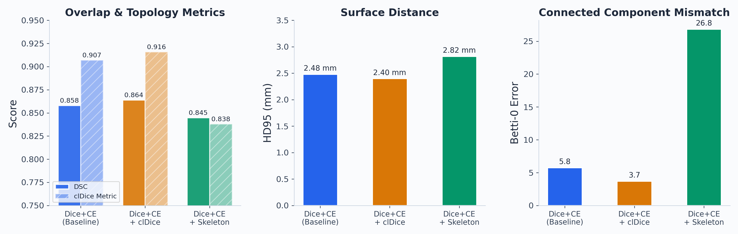
Global Results — From Scratch
clDice wins aggregate
DSC 0.864 | clDice 0.916
Lowest Betti-0 error: 3.72
Baseline close behind
DSC 0.858 | clDice 0.907
Betti-0 error: 5.76
Skeleton Recall
Lower aggregate (DSC 0.845)
High B0 error: 26.84 (over-segments)

Slide 16
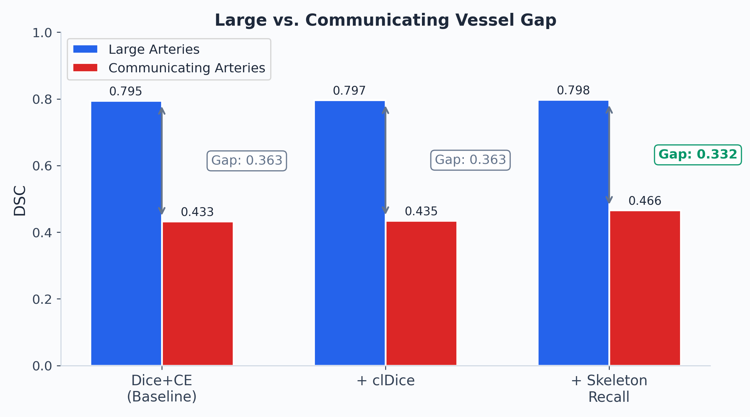
Stratified Results — The Vessel Gap
Skeleton Recall → Pcom Improvement
R-Pcom: 0.511 vs 0.459 baseline (+5 pts)
L-Pcom: 0.479 vs 0.410 baseline (+7 pts)
Vessel Gap Analysis
Model | Large | Comm. | Δ
Dice+CE | 0.795 | 0.433 | 0.363
+ clDice | 0.797 | 0.435 | 0.363
+ Skeleton | 0.798 | 0.466 | 0.332
Hypothesis partially supported: modest but targeted improvement on communicating arteries

Slide 17
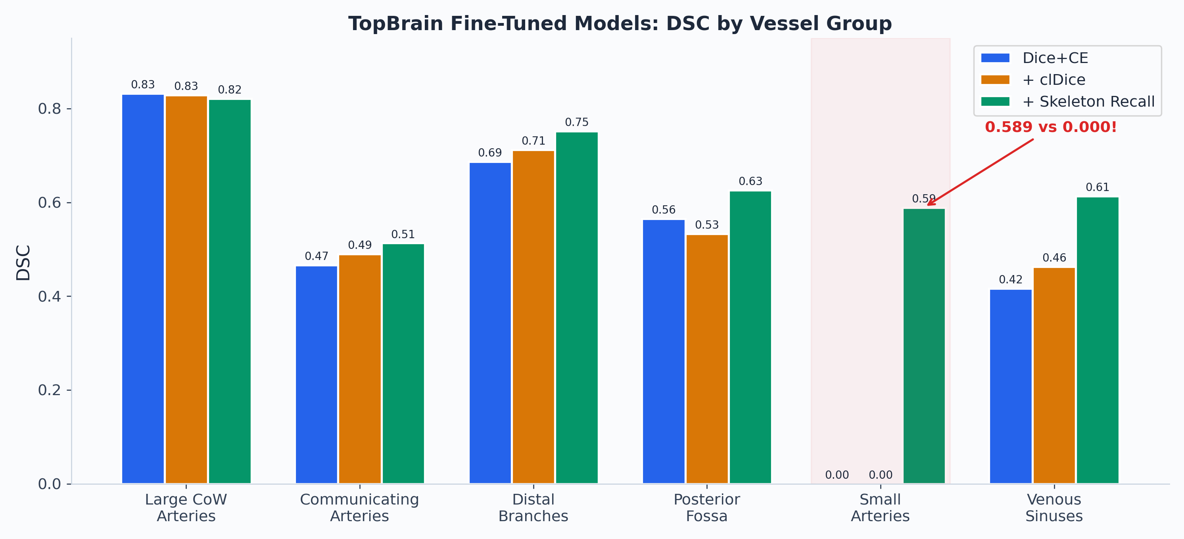
TopBrain Fine-Tuning — The Big Result
SMALL ARTERIES
(Ophthalmic, Ant. Choroidal)
0.589
Skeleton Recall
0.000 Dice+CE
0.000 clDice
Posterior fossa:
0.626 vs 0.565 (Dice+CE)
Venous sinuses:
0.613 vs 0.416 (Dice+CE)
Distal branches:
0.752 vs 0.687 (Dice+CE)
Large CoW:
all ~0.82 (comparable)
Skeleton Recall finds vessels the others cannot — a qualitative, not merely quantitative, difference

Slide 18
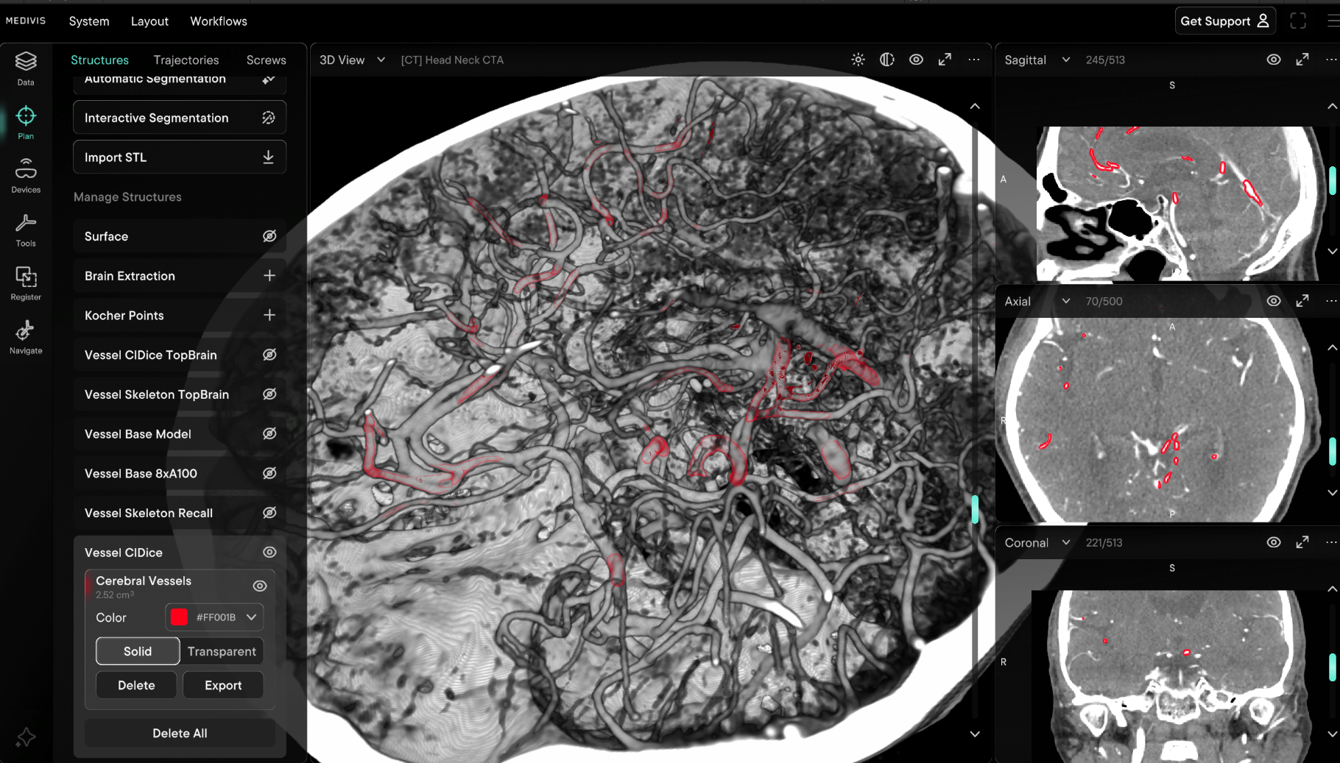
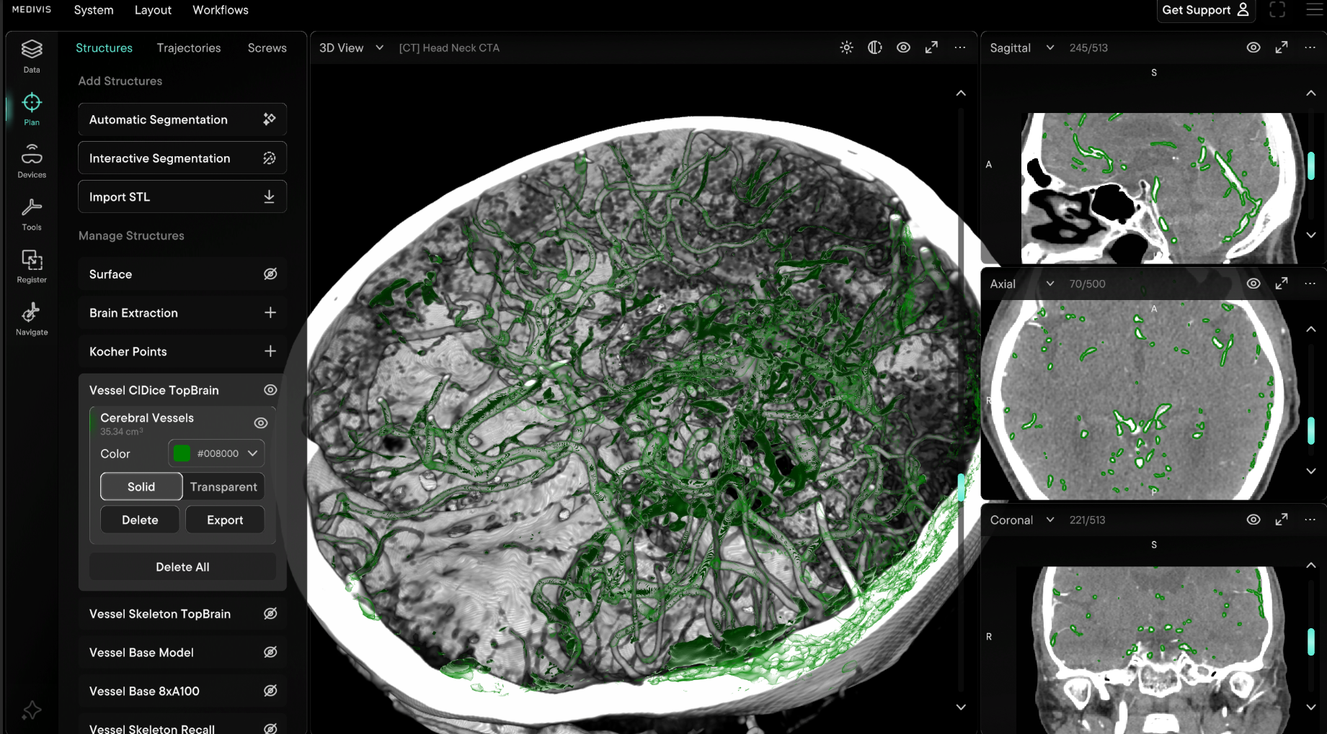
Qualitative Comparison — 3D Renderings
[SurgicalAR Screenshot]
ClDice
clDice + TopBrain finetuning
Same patient | Same viewing angle
Notes:
▎ "This is the same clDice model, same patient, same viewing angle. On the left is the model trained only on TopCoW's 13 Circle of Willis classes. It captures the major arteries — you can see the ICA, MCA, basilar —
▎ but the coverage is limited to just the core CoW structures."
▎
▎ "On the right is that same model after fine-tuning on TopBrain's 40-class labels. The difference is dramatic — distal branches, posterior fossa vessels, and smaller arteries all appear. This is the primary finding:
▎ TopBrain fine-tuning is what drives comprehensive vessel coverage. The model goes from segmenting just the arterial ring to capturing a substantial portion of the full cerebrovascular tree."
▎
▎ "The quantitative differences between loss functions — Skeleton Recall's advantage on small arteries, clDice's cleaner topology — operate within this expanded coverage. Both topology-aware models produce
▎ similar-looking full-brain segmentations after TopBrain fine-tuning; the measurable differences are at the sub-millimeter scale on the thinnest structures."

Slide 19
Discussion — What We Learned
clDice
Skeleton Recall
Best Aggregate Model
Best Thin-Vessel Transfer
DSC 0.864 | Betti-0 error 3.72
Pcom: +5–7 pts | Small arteries: 0.589
Improves topological precision
Improves topological recall
Fewer disconnected fragments
Over-segments (B0 error 26.84)
Best for: overall segmentation quality
Best for: finding every vessel
KEY INSIGHT
TopBrain fine-tuning drives comprehensive vessel coverage for all models.
The loss function used during pretraining shapes the quality of that transfer to the thinnest structures. Skeleton Recall's centerline-focused gradient signal creates feature representations that encode thin tubular geometry — a representational advantage that transfers when exposed to richer annotations.
Notes:
> "So what did we learn? Our hypothesis is partially supported. At the CoW scale, the improvement on communicating arteries is modest — 3 to 7 points DSC from Skeleton Recall. But when we test transfer to truly thin structures via TopBrain, the effect is dramatic."
>
> "The two topology-aware losses serve different purposes, and this maps to a precision-versus-recall trade-off at the topological level. clDice improves both overlap and topological precision — lowest Betti-0 error, fewest fragments. Skeleton Recall improves topological recall — it finds vessels that nothing else can, but it over-segments, producing fragments that need post-processing."
>
> "The key insight is that TopBrain fine-tuning drives comprehensive vessel coverage for all models, but the loss function used during pretraining shapes the quality of that transfer to the thinnest structures. Skeleton Recall's centerline-focused gradient signal during pretraining apparently shapes the network's feature hierarchy to better encode thin tubular geometry."

Slide 20
Limitations & Future Work
Limitations
Future Work
Large-small vessel gap persists
Wider HU window [0, 1500]
>0.33 DSC across all models
Separate bone from vessels — highest-impact fix
Skeleton Recall over-fragments
Class-balanced sampling
Betti-0 error 26.84 needs post-processing
Focus on under-represented thin vessels
HU window [0, 600]
Connected component filtering
Clips bone to same range as vessels → false positives
Remove small disconnected false positives
Retrain on corrected labels
50 model-assisted labeled CTAs on RedBrick AI
Notes:
"Some important limitations. The large-small vessel gap above 0.33 DSC persists across all models — communicating arteries remain fundamentally hard. Skeleton Recall's high Betti-0 error of 26.84 means fragmented predictions that need connected-component post-processing. Our HU window of 0 to 600 clips bone into the same intensity range as contrast-enhanced vessels, causing false positives near the skull base."
>
> "Future work: widening the HU window to separate bone from vessels, class-balanced sampling strategies to focus on under-represented thin vessels, and retraining on corrected labels from our model-assisted annotation pipeline — we've already uploaded pre-labeled masks for 50 unlabeled CTA volumes to a RedBrick AI annotation platform for expert correction."

Slide 21
Conclusion
Controlled ablation on identical hardware
3 loss functions, same 3D U-Net, same 8× A100 configuration
clDice = best aggregate model
DSC 0.864, lowest Betti-0 error 3.72, best topological precision
Skeleton Recall = best thin-vessel transfer
+5–7 pts on Pcom, 0.589 on small arteries vs zero for alternatives
Topology-aware pretraining creates better representations
Loss function during pretraining shapes how well coverage transfers to thinnest structures
Hypothesis partially supported
Modest CoW improvement; dramatic effect on truly small vessels after transfer
The large-vs-small vessel gap remains the central challenge — the arteries that matter most clinically are the hardest to find.
Notes:
To conclude: we ran a controlled three-way ablation comparing loss functions for cerebral CTA vessel segmentation on identical hardware. clDice provides the best aggregate metrics — highest DSC, lowest Betti-0 error. Skeleton Recall provides the best thin-vessel transfer — 0.589 DSC on small arteries where both alternatives score zero. Topology-aware pretraining creates representations that generalize better to thin tubular structures."
>
> "The large-versus-small vessel gap remains the central challenge in cerebrovascular segmentation. The arteries that matter most clinically are the hardest to find. Thank you."

Slide 22
Thank You
Questions?
Samih Tharwat Amer
Whiting School of Engineering | Johns Hopkins University

